Slide 1
Sprint #8 Presentation
Jamil Khan, Chaz Del Prato, Benjamin Seo, Christine Duong, Brandon Le, John Him

Slide 2
Product Overview
We have a total of 27 User Stories that can be broken down into 3 Epics.
As a pick-up sport player (Most significant)
As a member of our management team
As an administrator of our product
Testing our product
White box testing
Perform tests based on the code just written.
We attempt to test every line of code that we write but there will always be tests that we will miss.
Test cases are created on the fly and performed after finishing a function.

Slide 3
Test Plan
Test Philosophy
Could you test everything you can think of? What criteria are you using to select what gets tested?
We will try to test everything we can think of but ultimately we miss a couple of test ideas when testing. The criteria is based on the user’s perspectives of their activities and how they use the product.
Are there different densities of testing across your code? Will less well understood code go through more testing? Is there a code that does not require testing?
We will test heavily on the primary functions of our product. We will focus less testing on more simple portions of the applications such as formatting and design. For less understood codes, they will be tested more than simple codes but not as much compared to codes for like machine learning.
Why would your selected testing program be sufficient? What criteria do you use for making that decision?
We believe that the selected testing program would be sufficient due to the coverage of priority. The criteria would be to test everything but through a priority-based system.

Slide 4
Test Plan
Test Workflow
What is your team’s test process?
Finish a function, then test it. Do this repeatedly until all of the functions are done. We will then connect those functions to each other and test the whole application.
How do you determine code coverage?.
We first decide who wants to do what tasks and have the remaining tasks split up.
Do bugs come back from users or from your own team affect your test program workflow?
Some bugs can affect our workflow since some bugs are unrelated to our project and come from dependencies our project runs on. Overall, we anticipate bugs to appear.

Slide 5
Test Plan
Test Design
Code paths
Basic Path Testing which is based on a White box testing method that defines test cases on the flows or logical paths that can be taken through the program. It involves execution of all possible blocks in a program and achieves maximum path coverage with the least number of test cases.
Code coverage estimation in terms of % lines of code tested
Estimate about 80% of our lines of code to be tested.
Environment
We will be testing with in the NPM environment ran through Command Prompt. This will allow us to test our code in our IDE and see the results pop up on our local host in close to real time.
Test code and data
We will use test code to help ensure that functions work and test data will constantly be a part of this project since we will need to ack as users using our product.
Version control methodology
We will be using GitHub to version control

Slide 6
Updates
Architecture and Design Document
Machine Learning Write Up
User manual
Management Plan
Gantt Chart
Burndown Chart
Project Tracking Matrix
Team Code Velocity
Sprint Retrospective

Slide 7
Architecture and Design Document
Machine Learning Write Up
Application Use Case
Before
Whenever someone wants to join or host a pick up game ahead of time without the hassle of going to the nearest park where there are uncertain amounts of people there willing to play a game with them.
After
Whenever a user wants a sport to be recommended to them based on their height and weight.

Slide 8
Architecture and Design Document
Machine Learning Write Up
Stakeholder’s Benefits
Before
Stakeholders will not waste time nor will they need to go far to find a pick up game. In addition, with the use of machine learning, users will find games that match their likings. This will result in better experience and faster networking.
After
Stakeholders will not waste time to explore what other sports best fits them. This will result in better experience and better networking.

Slide 9
Architecture and Design Document
Machine Learning Write Up
Features/Label our Model Training Need
features: {weight, height}
label: {sport}

Slide 10
Machine Learning
Purpose of the model is recommend a sport for a new user based on his metrics
Used a decision tree model to achieve
Source of the training data was randomly generated values for height, weight, and labels
Can improve the accuracy, slightly, by using a real data set and having more features

Slide 11
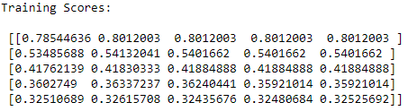
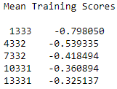
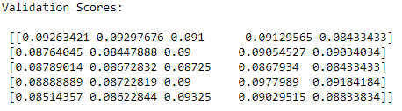
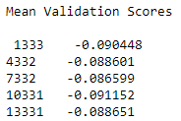
Machine Learning
Does the model overfit or underfit the data and how could you tell?
Cannot really tell
Plotted Learning Curve but not sure if we did it correctly to explain whether it underfits or overfits. The plot seems to be incorrect?
Used learning_curve() from SKLearn instead of mlxtend.plotting
Had a lot of errors in trying to use mlxtend.plotting plot_learning_curves()
Notes:
Ben

Slide 12
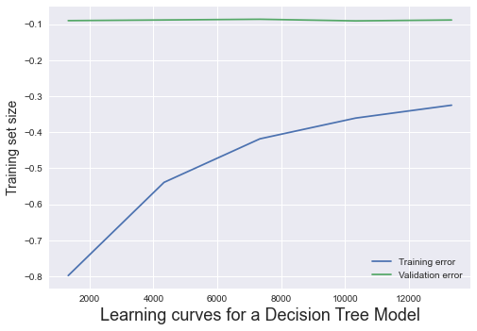
Machine Learning
Notes:
Ben

Slide 13
Machine Learning
Alternately considered Random Forest
Actually tried both when training and testing our dataset. We have noticed that both decision tree and random forest fluctuates depending on the amount and quality of our dataset.
Most of the time, the difference between both aren’t vastly different
For our current dataset, Decision Tree Classifier had the better accuracy than Random Forest.
Notes:
Ben

Slide 14
Machine Learning
What are the accuracies obtained by the machine learning model for the training set and for the validation or test set?
Training Set Accuracy
0.093
Testing Set Accuracy
0.1475
Low Accuracy due to 10+ classes with unequal data for each and features merging with other classes
i.e. a player that is 6’1” that is 210 lbs can be a basketball player AND baseball player since the features are the same for these classes.
Notes:
Ben

Slide 15
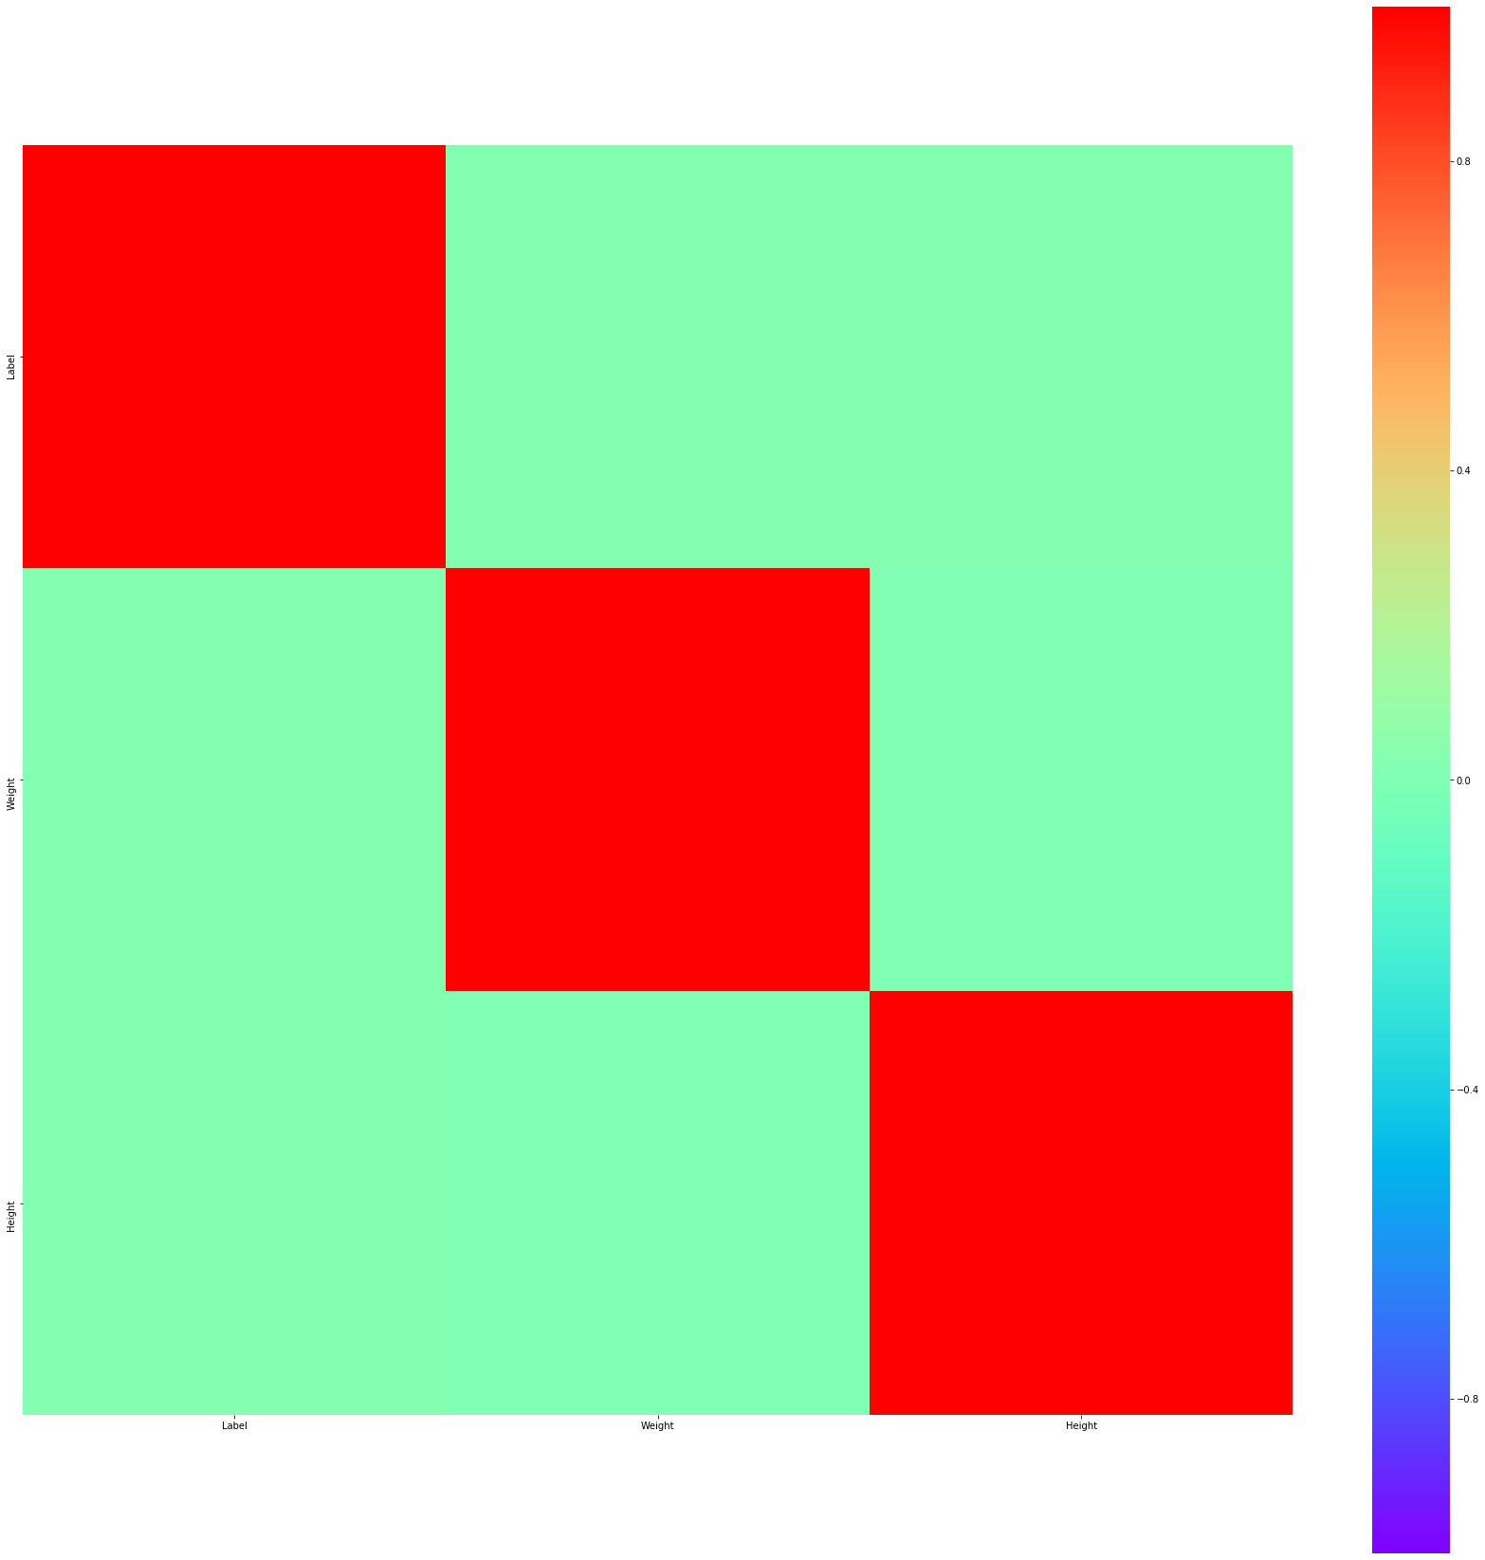
Feature and Label Correlation
Notes:
Ben

Slide 16
Technology innovation
What technology innovation and depth has the team provided other than machine learning model?
Nothing

Slide 17
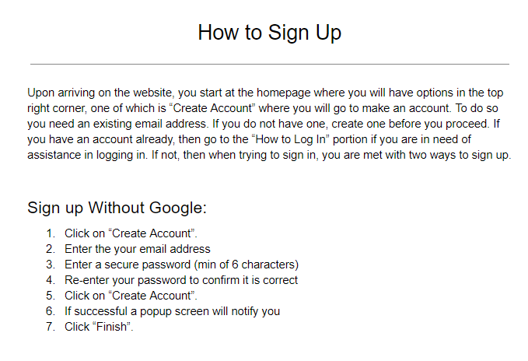
User Manual

Slide 18
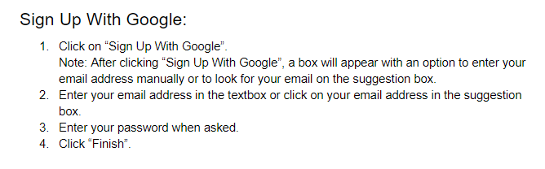
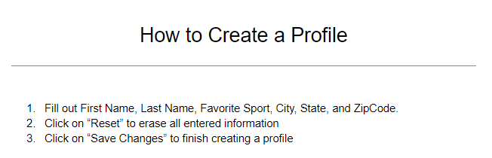
User Manual

Slide 19
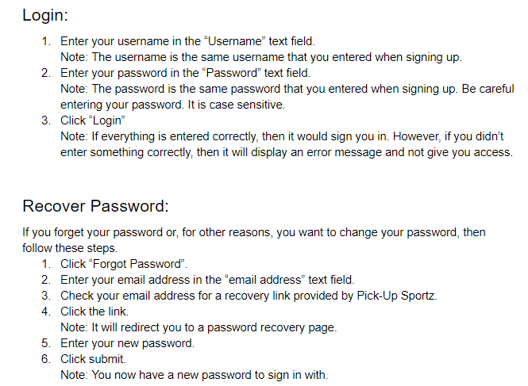
User Manual

Slide 20
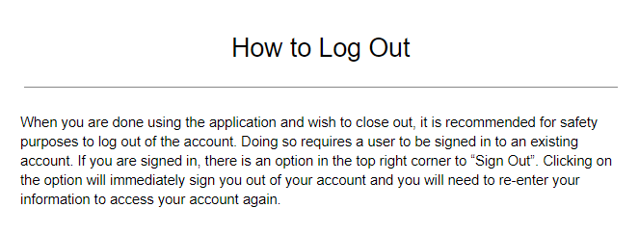
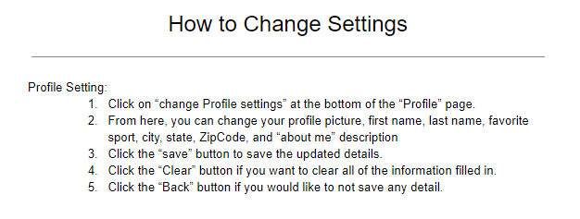
User Manual

Slide 21
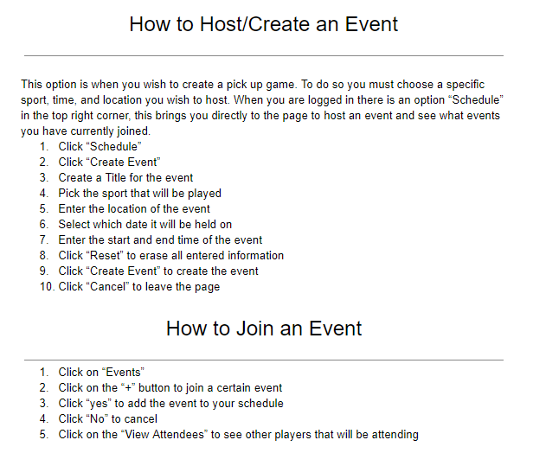
User Manual

Slide 22
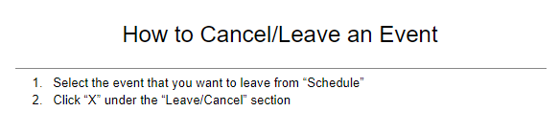
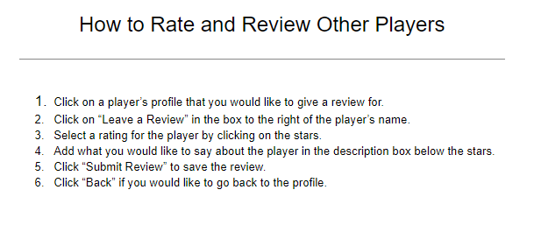
User Manual

Slide 23
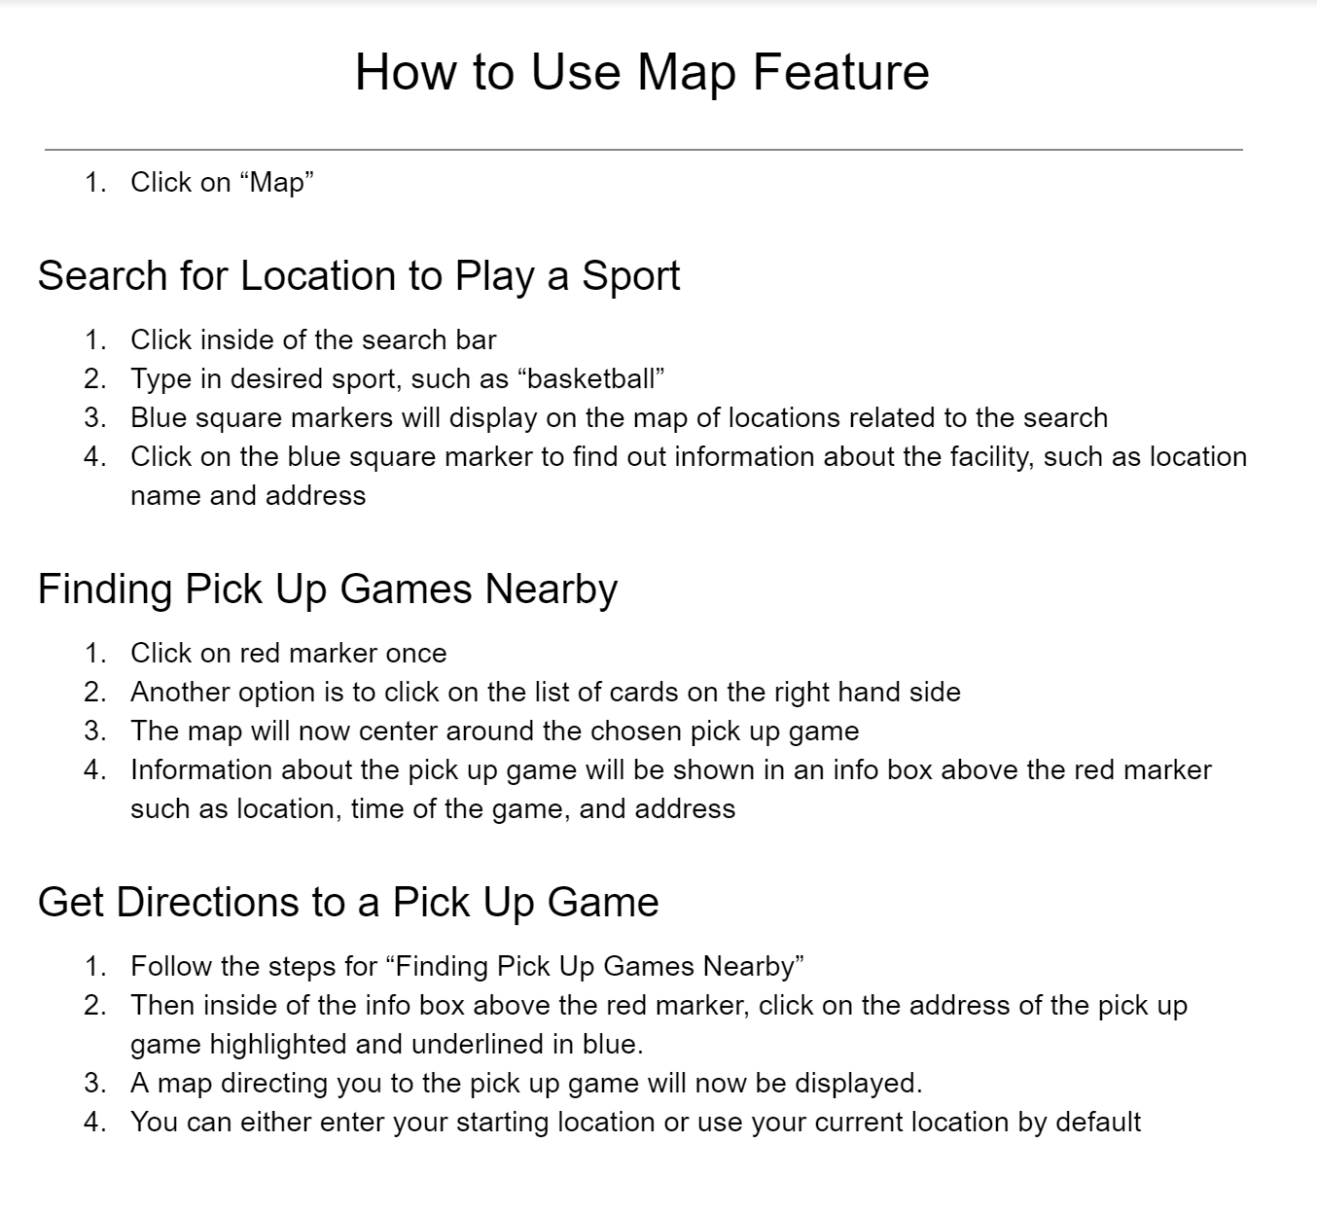
User Manual

Slide 24
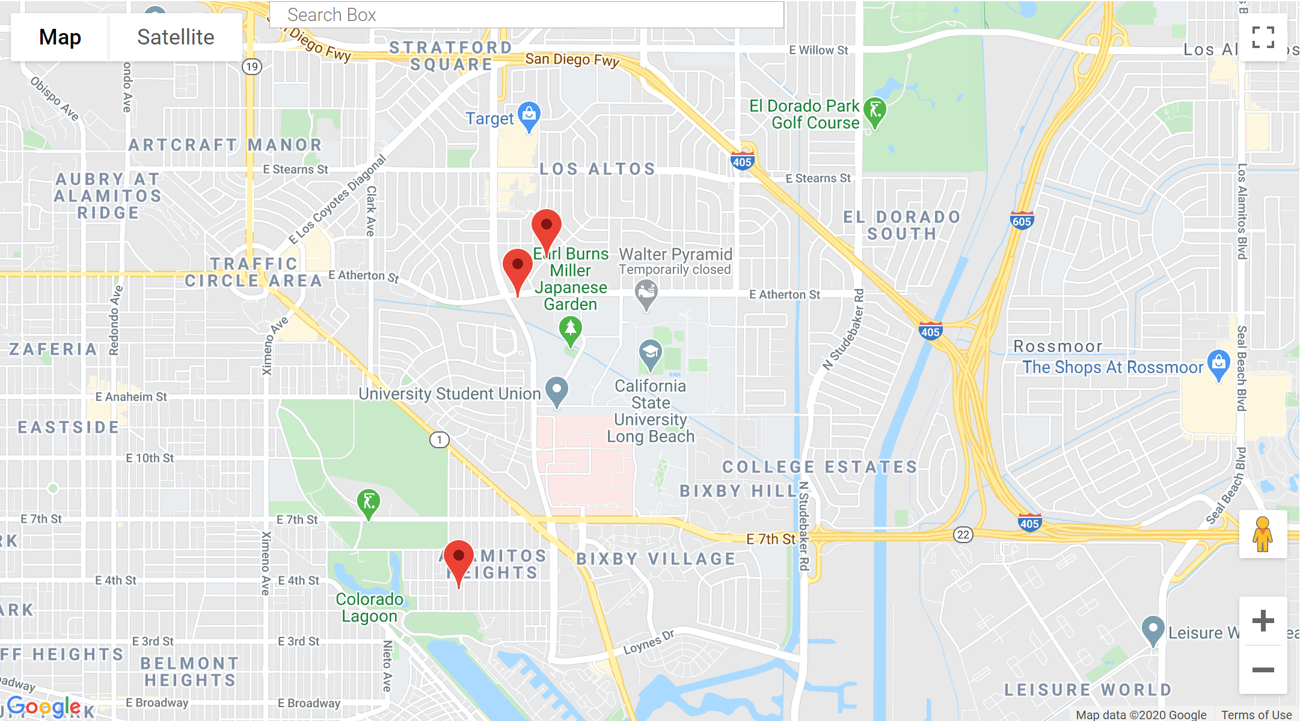
Map

Slide 25
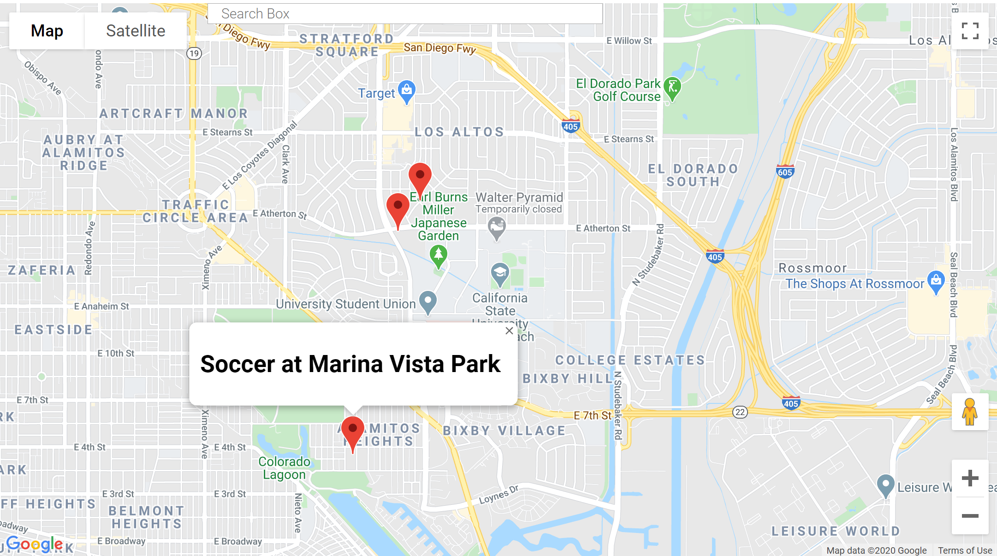
Map

Slide 26
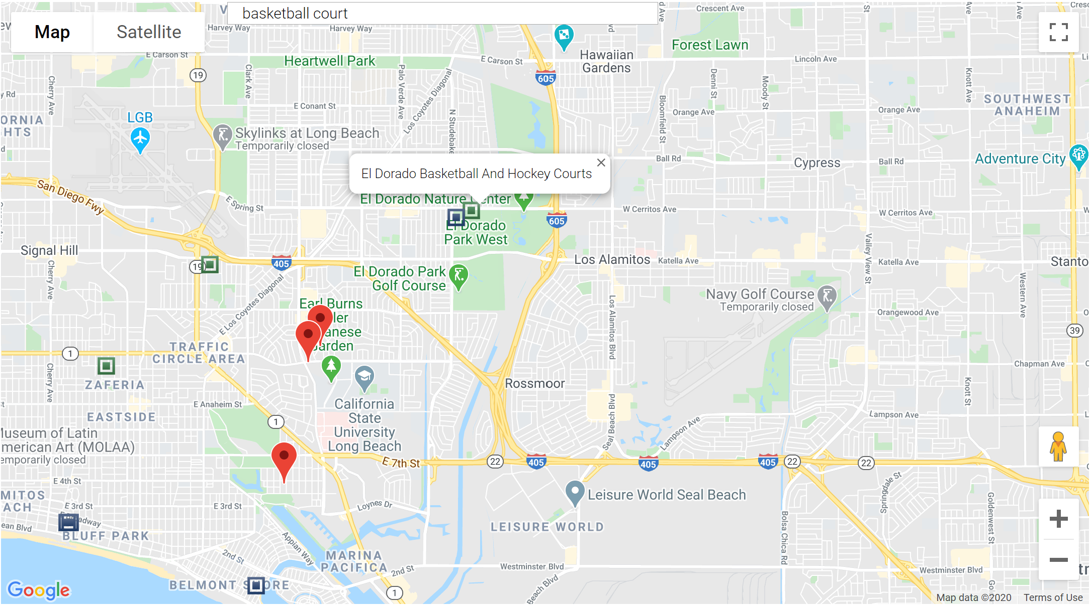
Map

Slide 27
Type of ORM, ODM Libraries or Drivers Used in the Connection of Database to Server
JSData
JSData converts data from JavaScript Objects to formats used by MySQL, MongoDB, RethinkDB, Firebase, etc. and vice versa

Slide 28
APIs and Servers
External 3rd Party APIs:
Google Sign in/ Sign up
Google Maps
Data Extracted from 3rd Party APIs:
Account Sign in/Sign up Credentials
Map (location) Data
Servers
We using Firebase Hosting, so we are serverless at this point.

Slide 29
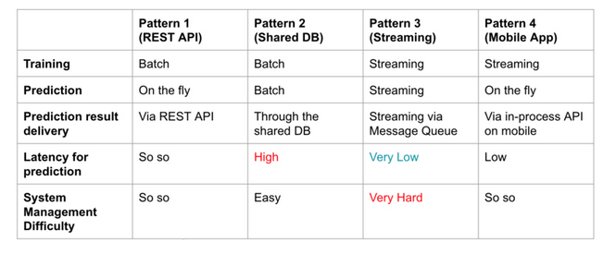
Machine Learning Deployment
How do we plan to deploy the machine learning model?
At the moment, we are planning on deploying our model as a Web API.
Alternative deployment architectures?
Shared Database, Streaming, MobileApp

Slide 30
Sprint Goals
Test model using Dataset
Apply ML model in either Node.js and show it on UI
Test from users perspective
List of Local park within certain range
Create Map Around User
Test all Functionality
Finish Star rating - own user can't rate their own profile
Finish Star rating - own user can rate other profile
Finish Testing model using data set
Create a map of the local area around school

Slide 31
User Stories for This Sprint
As a Player:
“I want to be recommend new sports to try, so that I can try a new sport”
“I want to be able to see the local area on a map, so that i know what parks are around”
As an App Admin:
“I want to have a product that runs without error, so that our customers can have an enjoyable experience”
As a Management Team:
“We want to be constantly training and testing our Machine Learning model within our application.”
“I want to have all of our documents done, so that we can finish our product.”

Slide 32
User Stories for This Sprint
User story priority is based on complexity and most time consuming.
Highest priority is implementing our ML model
Second Highest Priority is Implementing Maps
Third Highest Priority is implementing additional user interactions.

Slide 33
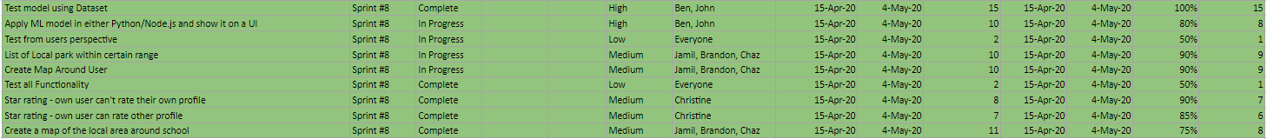
Project Planning Matrix

Slide 34
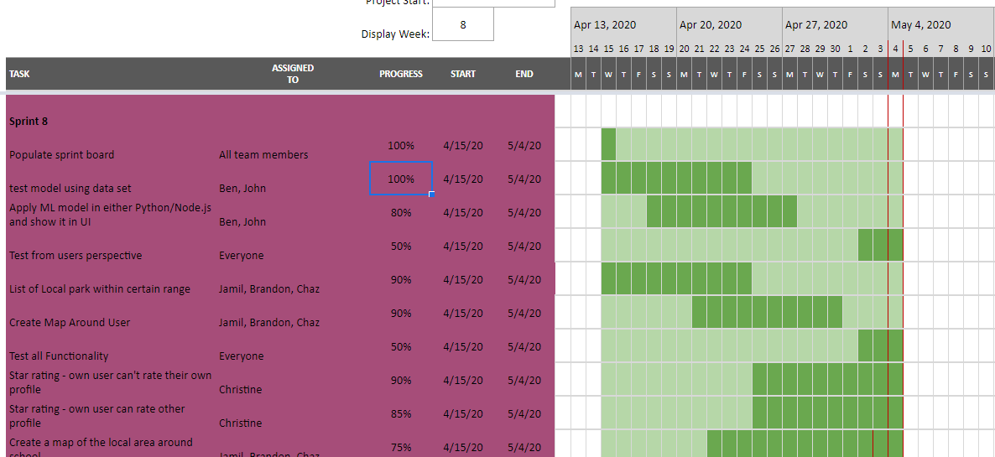
Gantt Chart

Slide 35
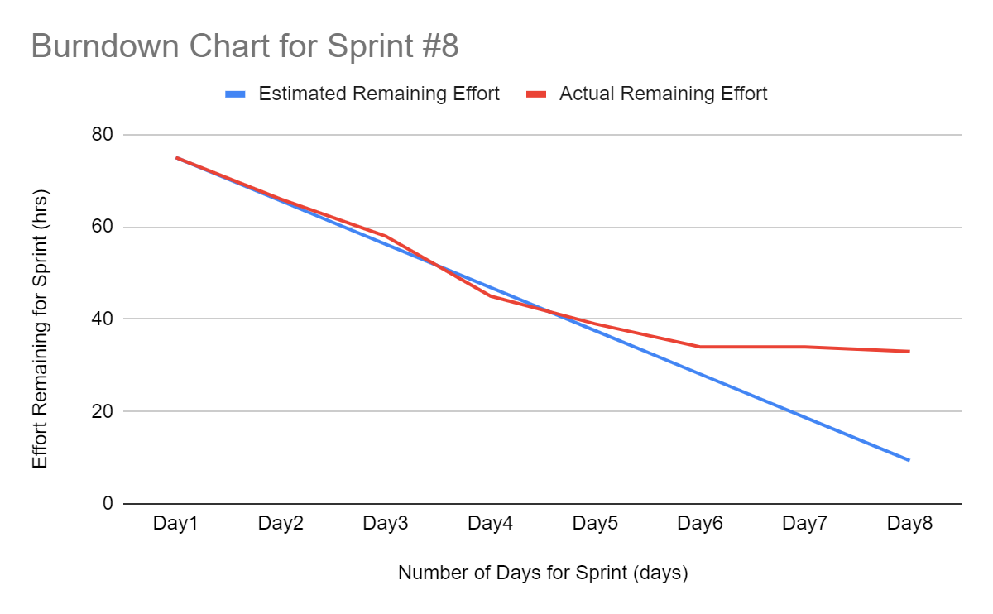
Burndown Curve

Slide 36
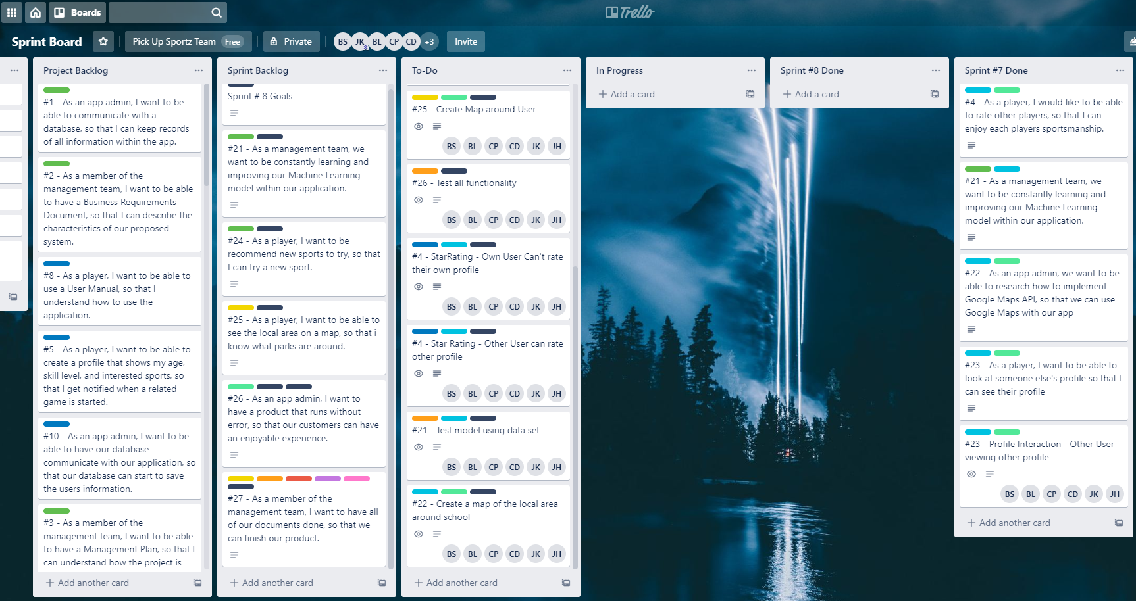
Sprint Board (Start)

Slide 37
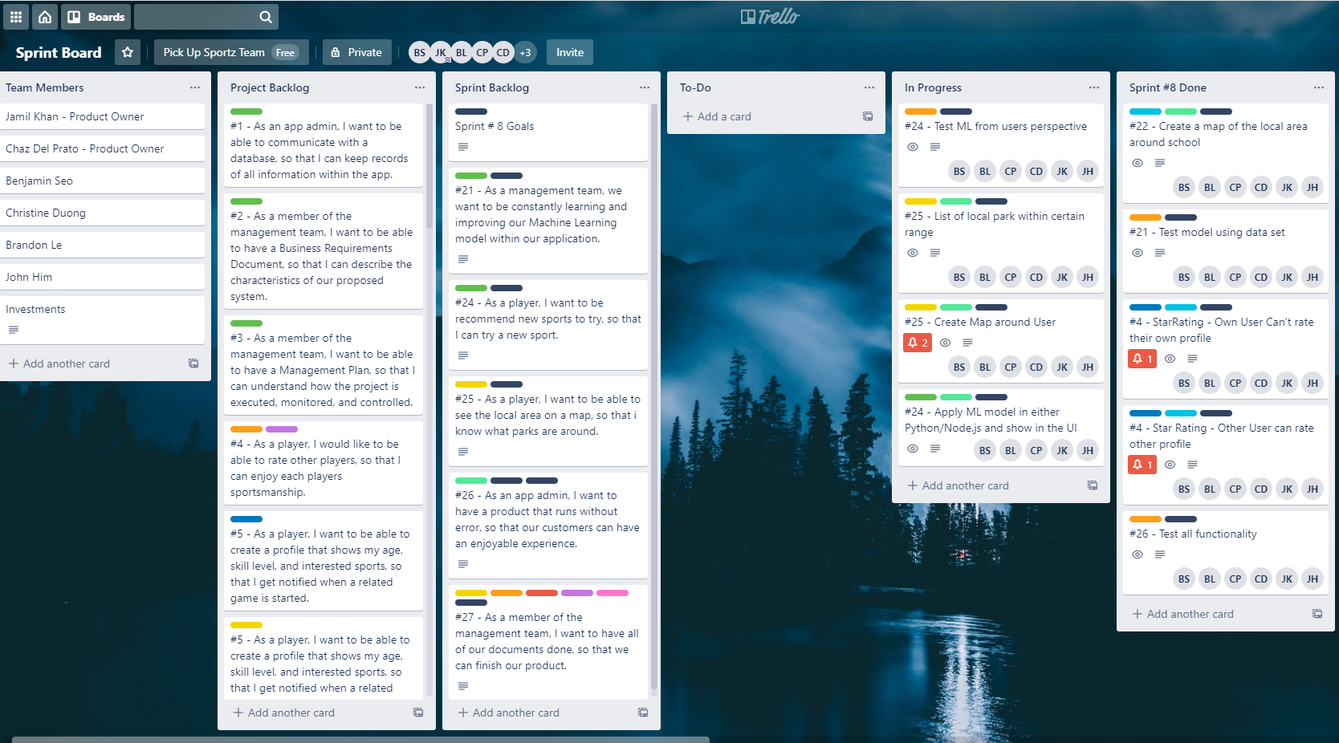
Sprint Board (End)

Slide 38
User Features
Completed(19)
Create Account
Create Profile
Log in
Log out
Change Password
View Profile
View Other Profile
Edit Profile
View Schedule
View Events
Create Event
Join Event
Cancel Event
Leave Event
View Available Events
Sort Through Schedule
Sort Through Events
View Ratings and Reviews
Leave Ratings and Reviews
In Progress(2)
Map Features
Recommending a sport to a user
Machine Learning Component

Slide 39
Sprint Retrospective
Our goal was to:
Test model using Dataset
Apply ML model in either Python/Node.js and show it on UI
Test from users perspective
List of Local park within certain range
Create Map Around User
Test all Functionality
Finish Star rating - own user can't rate their own profile
Finish Star rating - own user can rate other profile
Finish Testing model using data set
Create a map of the local area around school

Slide 40
Sprint Retrospective (continued)
Our team’s total velocity is :
5 hours x 3 weeks x 6 members = 90 hours (story points).
We were not able to meet our sprint goal.
Didn’t Finish:
Implementing Machine Learning Component to Web Application
Fully implement the map component

Slide 41
Sprint Retrospective (continued)
Current hours worked:
64 hours worked
Burndown Chart Analysis:
Kept on track but later had to deal with some bugs and other issues that kept us from reaching our goals.

Slide 42
Code Evaluation
User Stories Implemented
For Sprint #8, we implemented:
As a player, I want to be able to view other player’s profile so that I can interact with others through the website
As a player, I want to be able to review a player so that all players can hold each other accountable and practice good sportsmanship
As a player, I want a map with pick up games so that I know what events are near me

Slide 43
Code Evaluation
Code Function
Create account with their own email
Sign in with their own account
Create an event
Join an event
Leave an event
Cancel an event
View their own profile
Logout
Create profile
Edit profile
Rating and reviewing a player
User’s schedule of events
View participants of an event
View another user’s profile

Slide 44
Application Review
https://pick-up-sportz-89c6e.firebaseapp.com/

